Slide 1

Slide 7
Future University in Egypt
Faculty of Computers and Information Technology
Slide 6
Supervised by
Prof: Neveen Ibrahim
DR: Samah Ahmed Zaki
Slide 5
Slide 4
Start
Slide 3
Mohamed Mahmoud El Badri 20194841
Mohab Khalid Mahmoud 20193015
Saif Eldin Ashraf Taha 20191737
Ibrahim Ayman Ibrahim 20193663
Andria Salah Roushdy 20191266
Omar Emad 20192796
Slide 2
Slide 1

Slide 2

Slide 7
Slide 6
Slide 5
LUDOS
Slide 4
Start
Slide 3
Slide 2
Slide 1

Slide 3


Slide 7
Today’s Topics
Slide 6
Our problem
Analysis
Slide 5
In this section, we will discuss the main problem that we built our project for.
In this section, we will discuss the process of determining the aspects of our project
Slide 4
Objectives
Architecture
The project's goals will be covered in this part, which will also attempt to achieve perfection.
In this section, we will oversee the architectural aspects of the development of our project
Slide 3
Slide 2
Scope
Design
In this section, we will show the people whom we target for our project.
In this section, we will show our mobile application UI and the website UI of our project.
Slide 1

Slide 4

Slide 7
Problem Description
Slide 6
Slide 5
Today's kids seem to spend too much time during the day using their own mobile smartphones and neglect the traditional way of learning.
Thus, our aim is to create free software that every child can use easily for learning and as a result, we chose to create a mobile educational application for kids.
Slide 4
Slide 3
Slide 2
Slide 1

Slide 5
Slide 7
Objectives
Slide 6
The goal of making it simple and fun for any child to be able to cultivate their cognitive, innovative, and creative abilities, Since there is no educational application that supports our Arabic language, our first priority is to deliver all game content in Arabic for Arab youngsters.
Our software will be divided into three sections:
For preschool:
We will teach kids the letters, and shapes of animals and their sounds, and concepts of math.
For m id d le school:
We will teach the children the concept of Advanced math, and the date and time.
For high school:
We will teach the children the concept of programming, and the concept of logic gates.
Slide 5
Slide 4
Slide 3
Slide 2
Slide 1

Slide 6



Slide 7
Scope
Slide 6
Our application's target users include the following but are not limited to:
Slide 5
Slide 4
Slide 3
Slide 2
Children between the ages of 5 and 12
Parents
Slide 1

Slide 7

Slide 7
Analysis
User Requirements
1) Parents Shall be able to make an account.
2) All users Shall be able to track his/her achievements.
3) All users Shall be able to track his/her progress of the game.
4) All users Shall be able to spend his/her points on buying games or avatars.
5) All users Shall be able to play games.
Slide 6
Slide 5
Slide 4
Slide 3
Slide 2
Slide 1

Slide 8
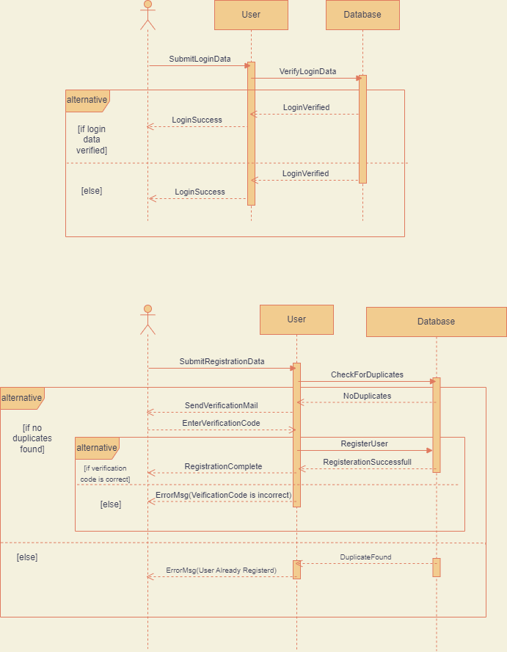
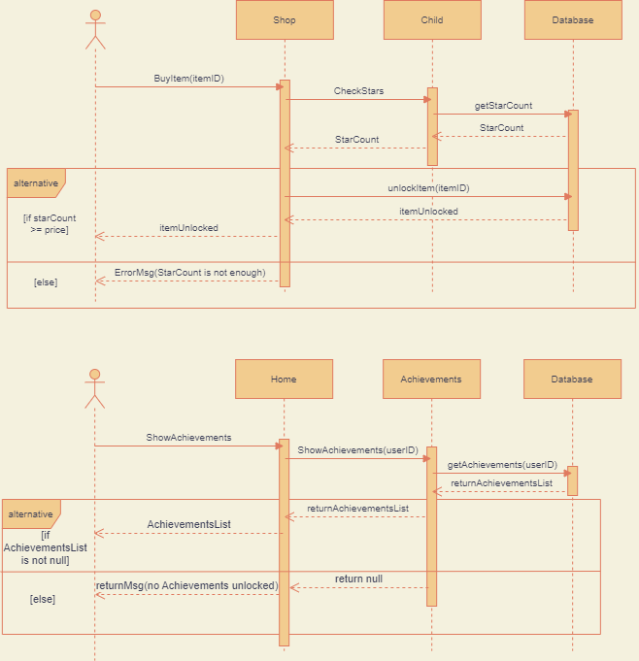
Slide 7
Sequence diagram
Slide 6
Slide 5
Slide 4
Slide 3
Slide 2
Slide 1

Slide 9
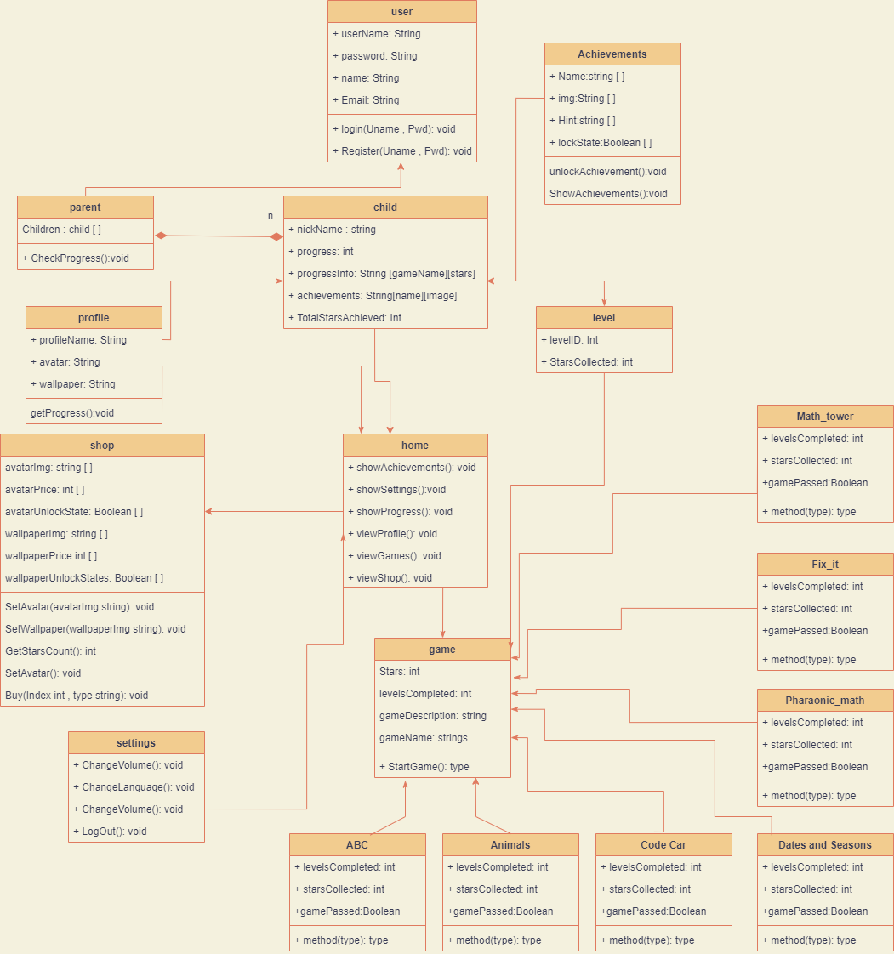
14
Slide 7
Class diagram
13
Slide 6
12
Slide 5
11
Slide 4
10
Slide 3
Slide 9
Slide 2
Slide 8
Slide 1

Slide 10
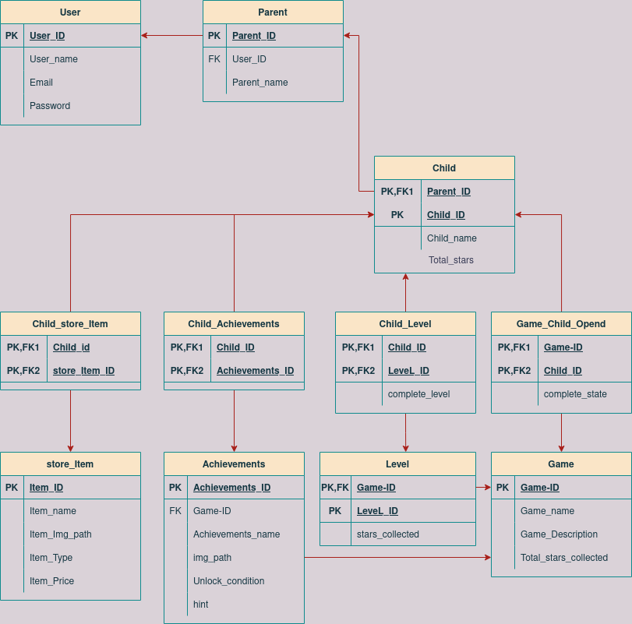
ERD
14
Slide 7
13
Slide 6
12
Slide 5
11
Slide 4
10
Slide 3
Slide 9
Slide 2
Slide 8
Slide 1

Slide 11
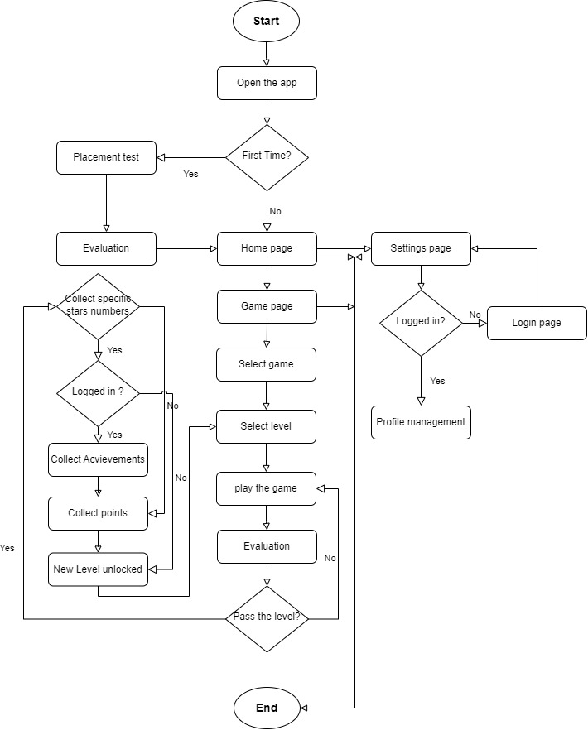
14
Flow chart
13
12
11
10
Slide 9
Slide 8

Slide 12
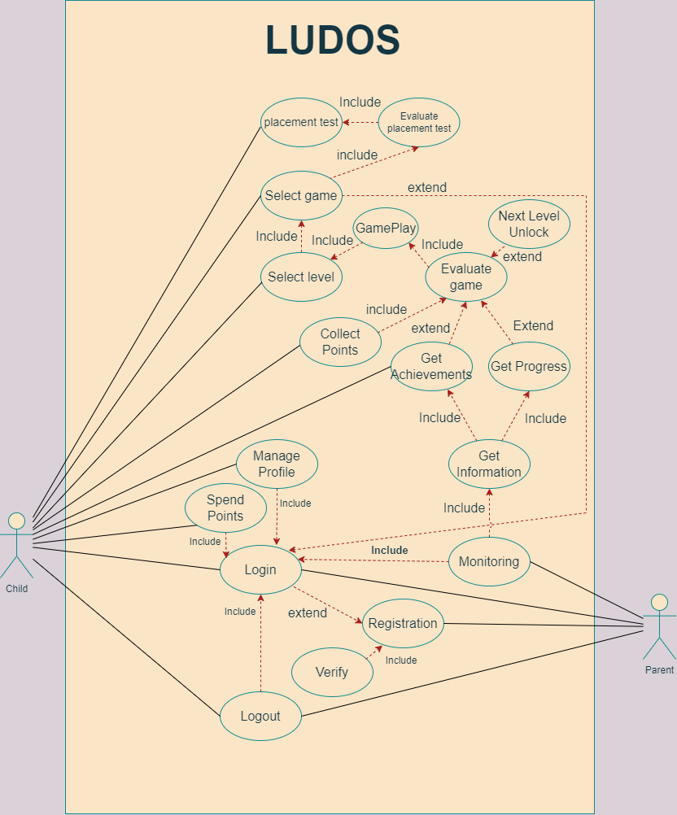
14
Use case diagram
13
12
11
10
Slide 9
Slide 8

Slide 13
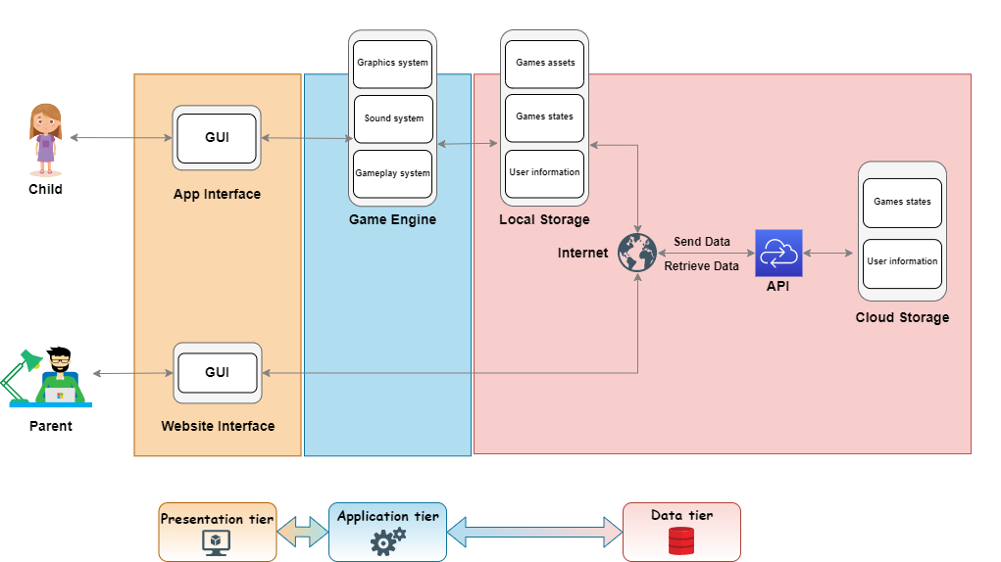
14
Architecture
13
12
11
10
Slide 9
Slide 8

Slide 14
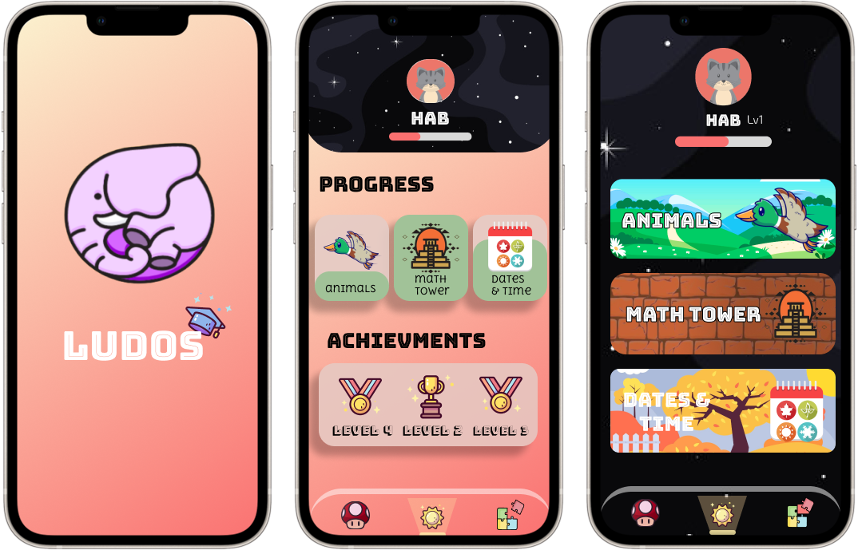
14
Design
13
12
11
10
Slide 9
Slide 8

Slide 15
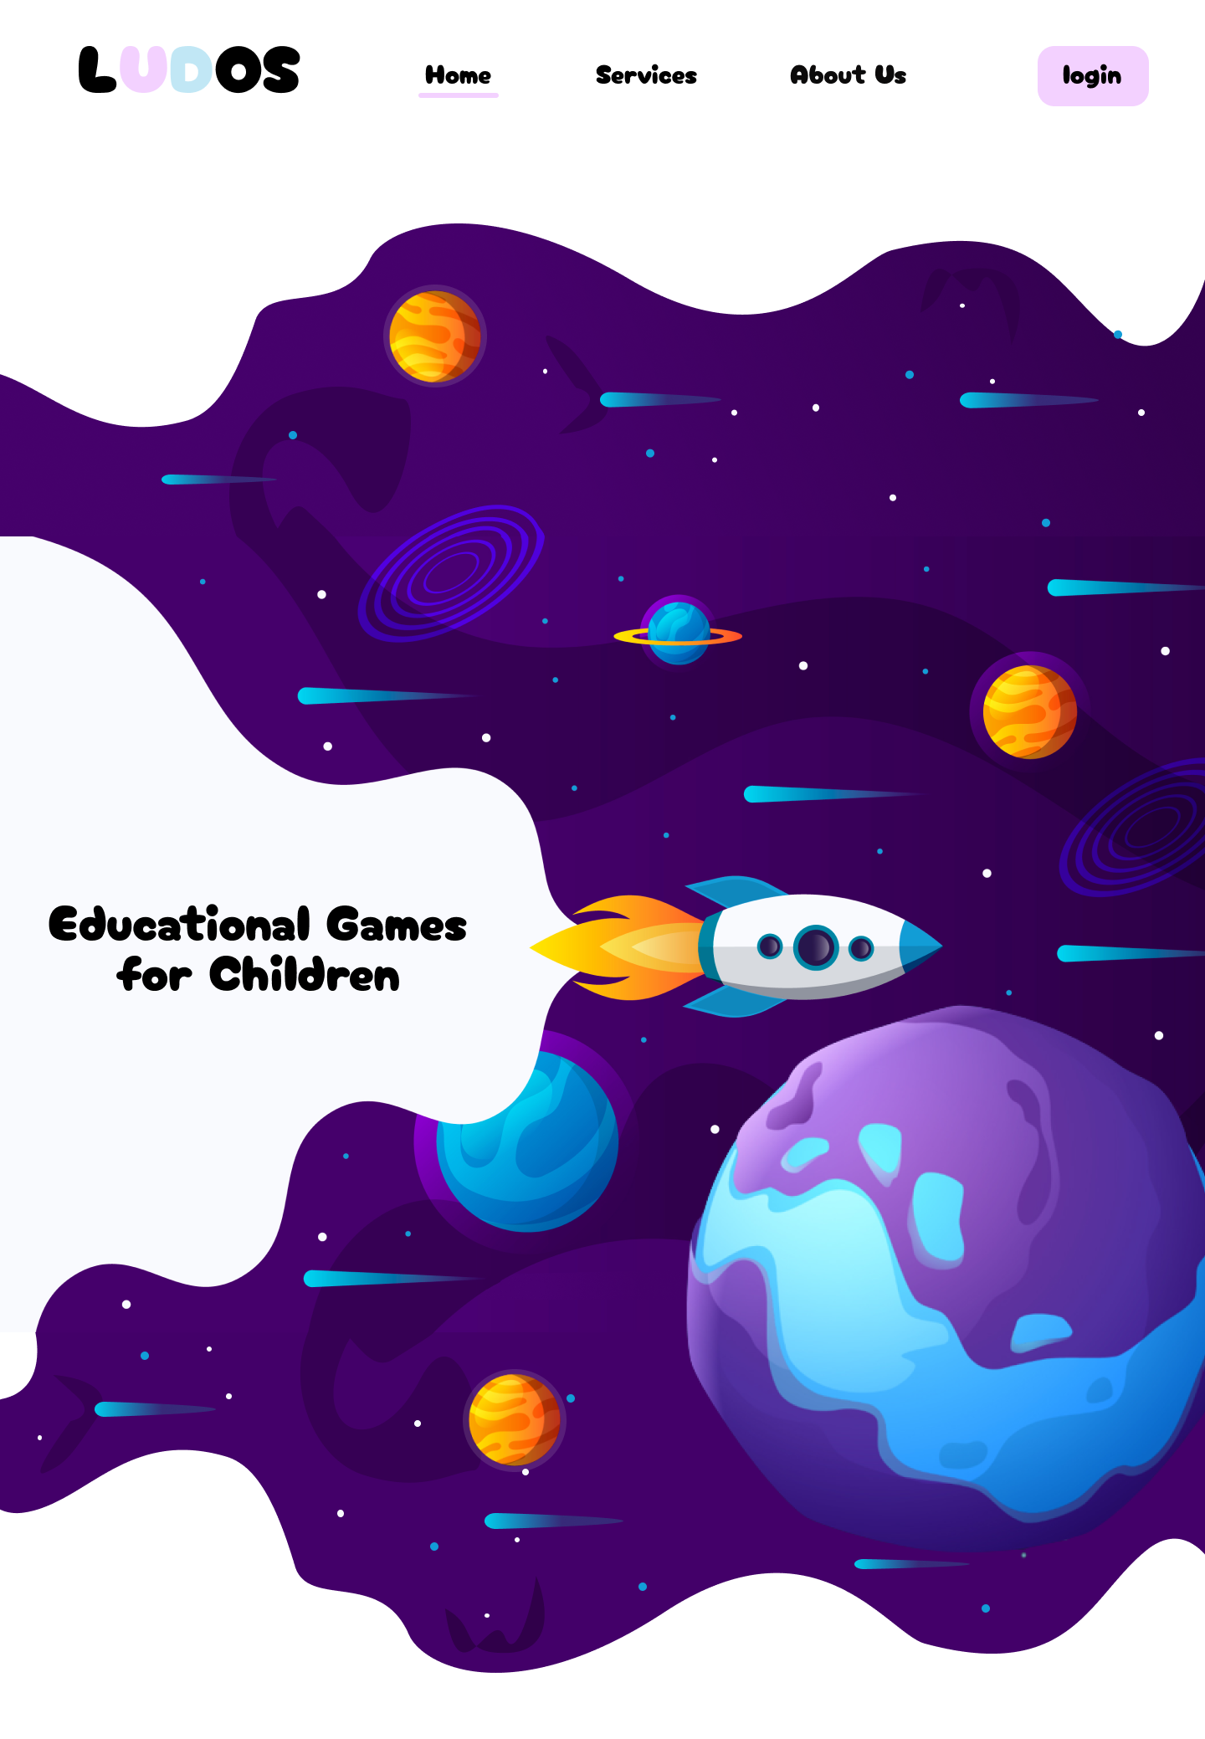
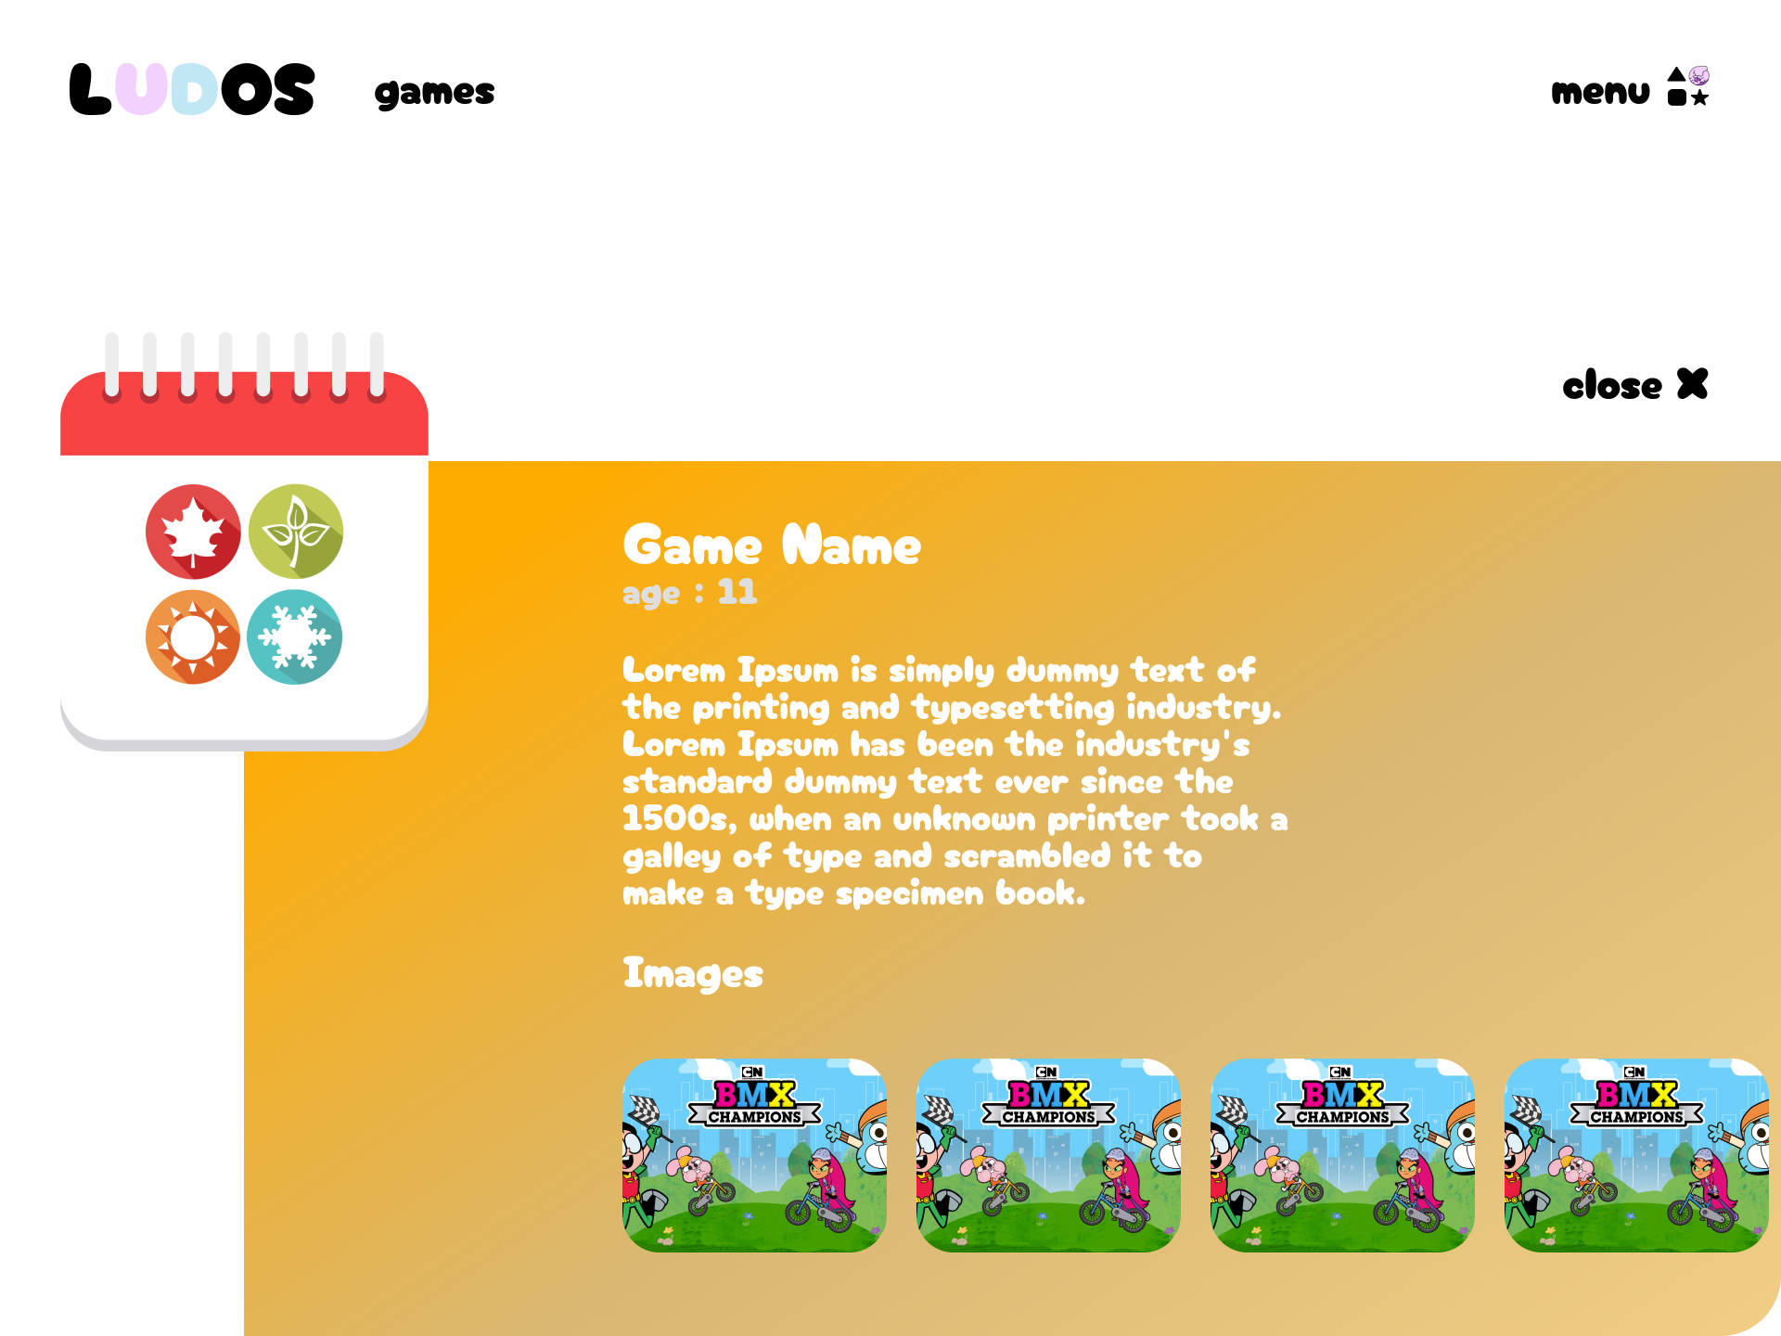
14
Our Website
13
12
11
10
Slide 9
Slide 8

Slide 16
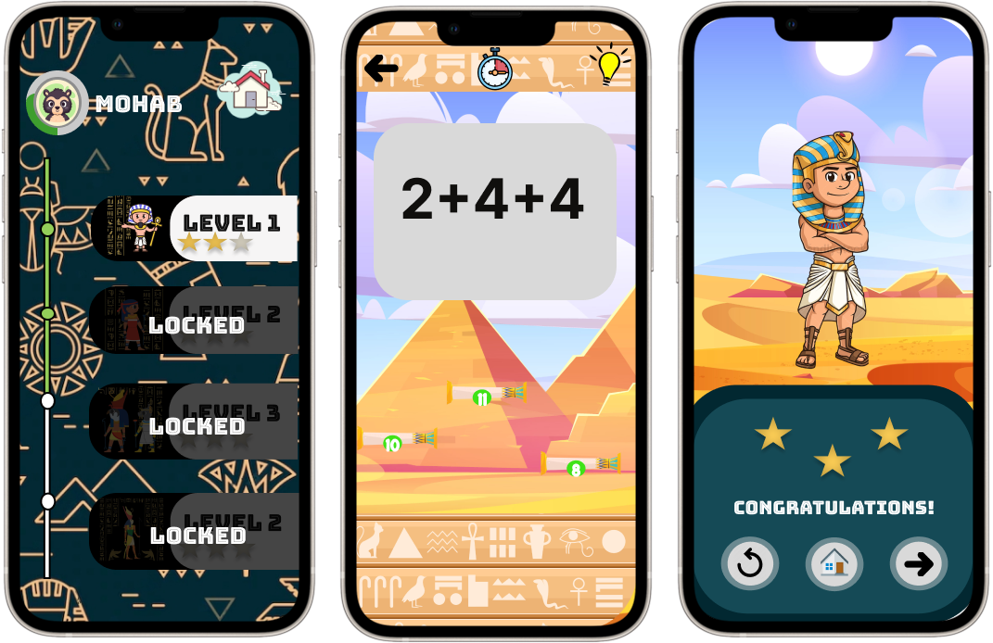
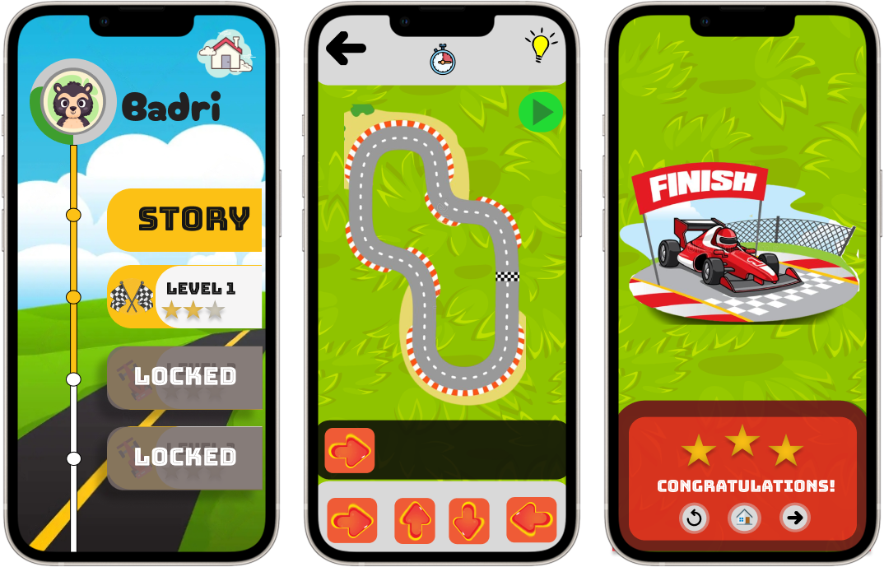
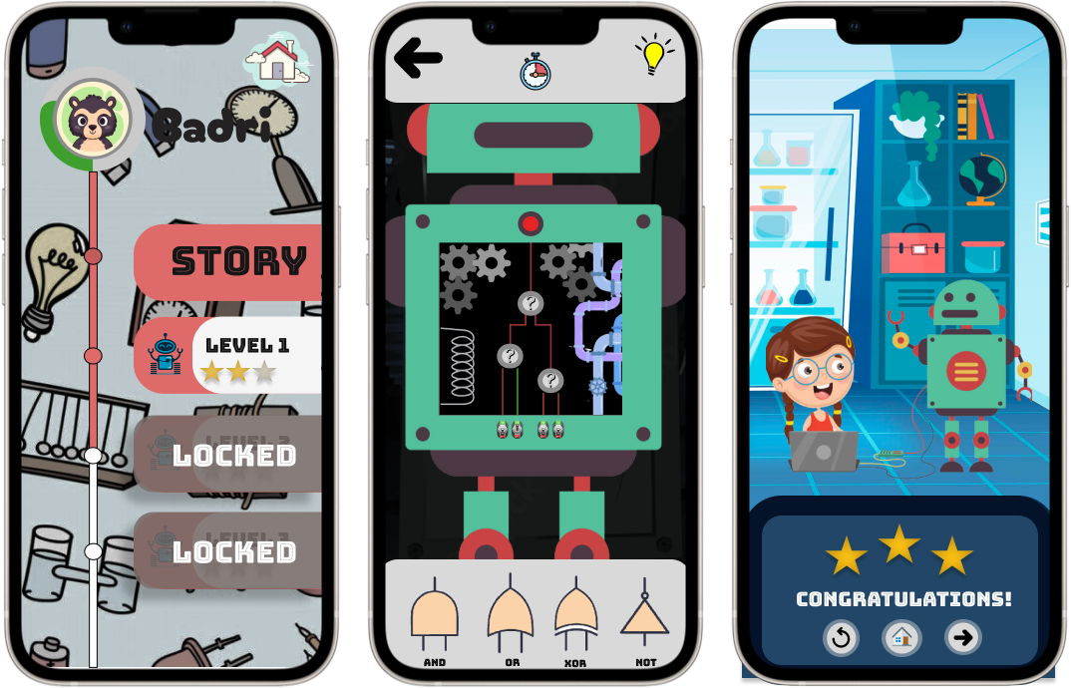
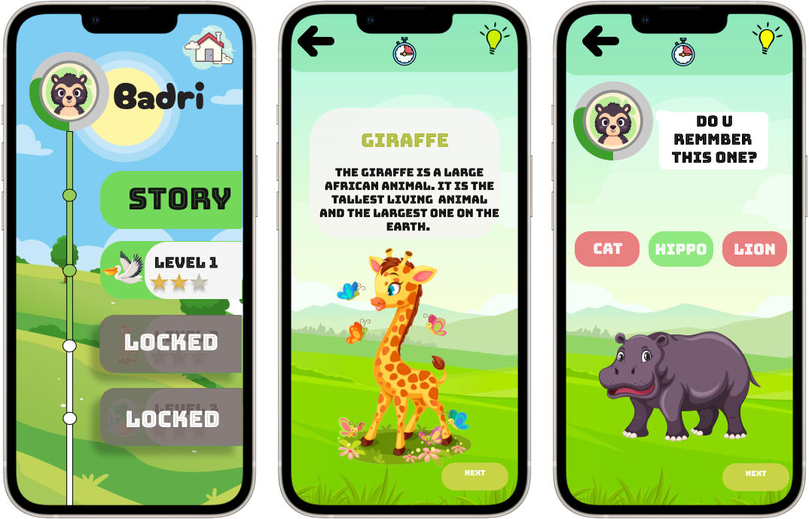
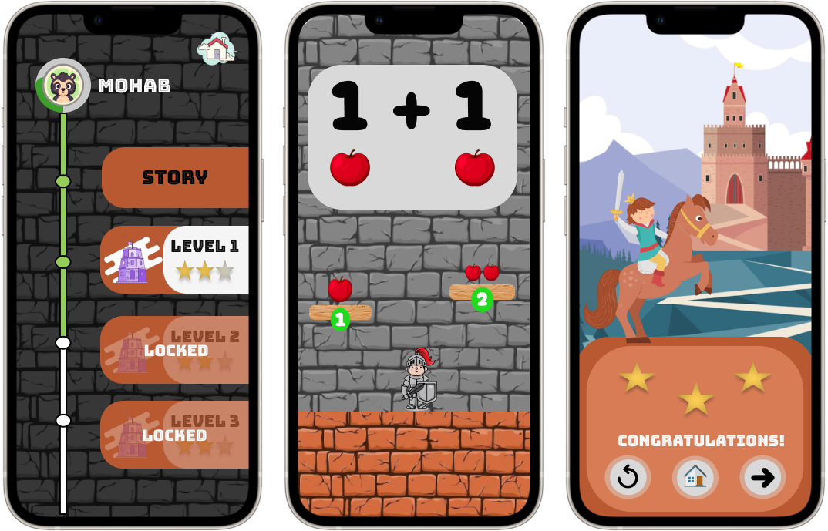
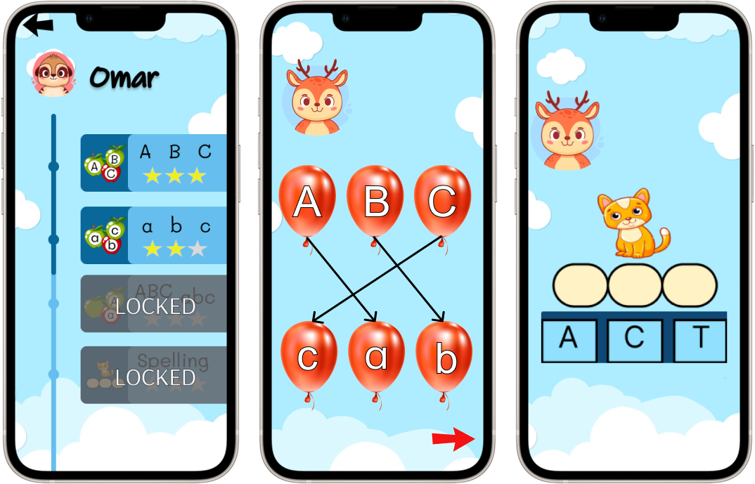
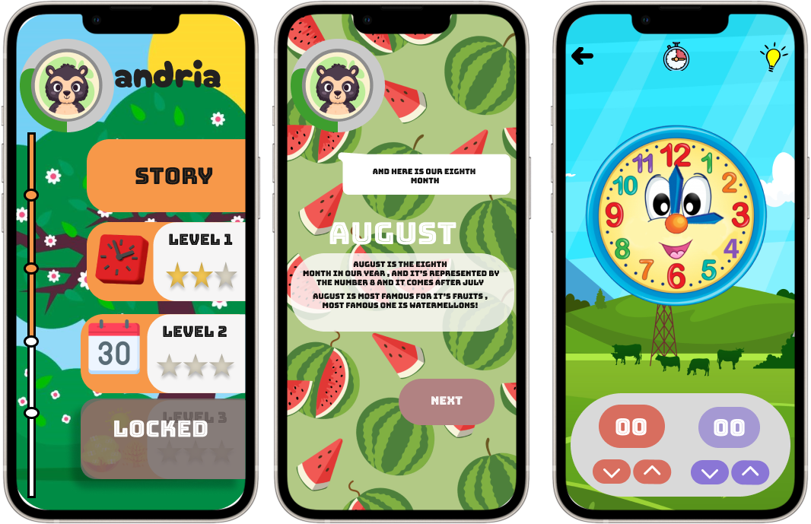
14
Our Games
13
12
11
10
Slide 9
Slide 8

Slide 17

Animals

Slide 18
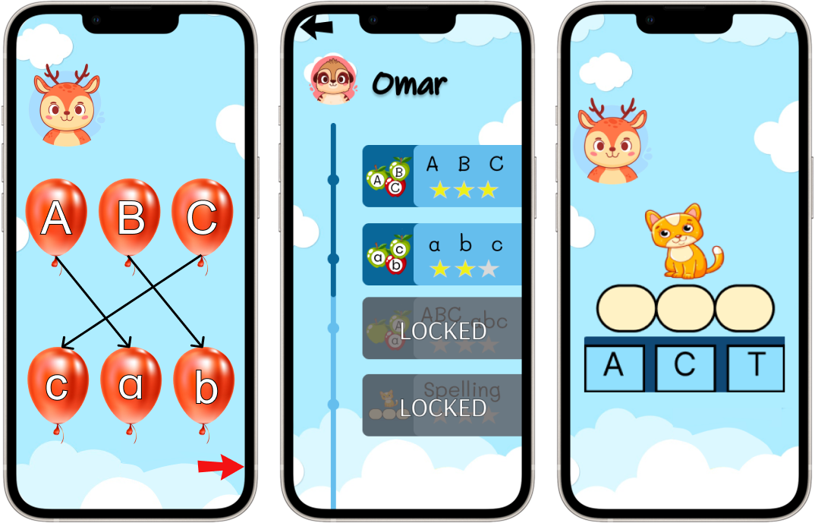

ABC

Slide 19

Math Tower

Slide 20

Date & Time

Slide 21

Math Tower Advanced

Slide 22

Logic gates

Slide 23
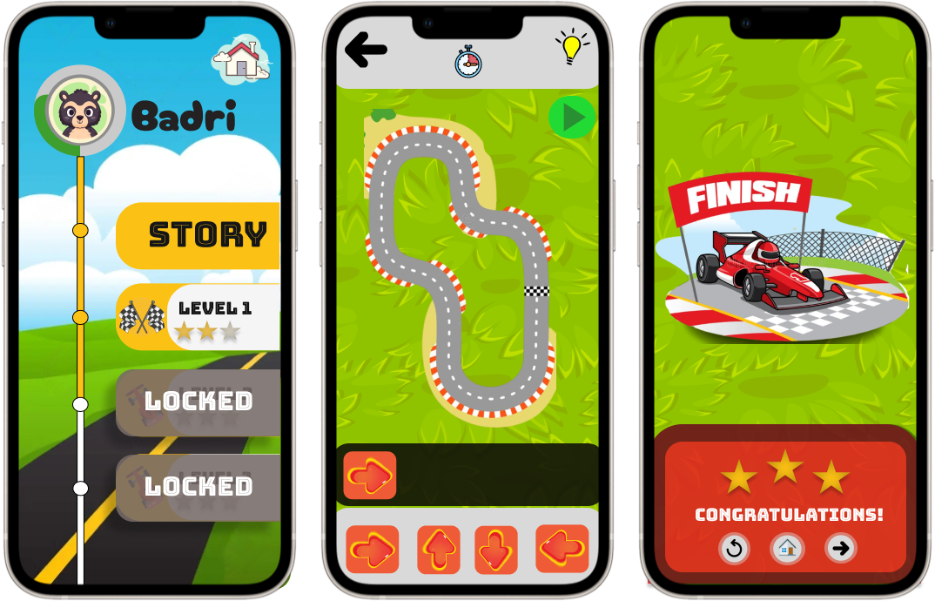

Code Cars

Slide 24
Thanks for Listening with great patience

Slide 25
Any Questions?

